Slide 1
SAP MM/ WM PRESENTATION
VISIT US AT
www.sap-topjobs.com

Slide 2
Warehouse Management (WM)
Objective
To understand
Warehouse concepts
Terminologies in WM
Movement types in WM
Difference between WM and IM
WM strategies

Slide 3
WM Concept

Slide 4
WM Concept
Warehouse management (WM) helps to identify the stock of a material at bin level.
It is a tool to assist in processing all goods movements and maintaining inventories in warehouse.

Slide 5
WM Integration
Warehouse management (WM) process are initiated by inventory management.
Apart from that, it is integrated with
SD Module
QM Module
PP Module

Slide 6
WM Integration with IM & SD
GR/GI and posting changes are initiated in IM and processed in WM
Shipping of SD Module integrates WM through delivery documents

Slide 7
WM Integration with PP & QM
WM integration with QM allows to trace the material inspection lot which are stored in the ware house
Supply area to provide the material for production, integrates WM with PP

Slide 8

Organization Structure with WM
Plant
Storage
Location
0001
Storage
Location
0002
Storage location
Assigned to the
Warehouse
Warehouse Number 001
Storage
Type 001
Storage
Type 002

Slide 9
WM Terminologies

Slide 10
Terminologies in WM
Storage Location: -
Physical storage within a plant for storage and movement of material.
It will reflect value at storage location level.
Warehouse: -
Physical area designated inside storage location. It is not concerned with value.

Slide 11
Terminologies in WM
Storage Location: -
Physical storage within a plant for storage and movement of material.
It will reflect value at storage location level.
Warehouse: -
Physical area designated inside storage location. It is not concerned with value.
Warehouse number uniquely identifies the warehouse.

Slide 12
Terminologies in WM
Storage Type: -
A grouping of storage according to its nature is storage type.
E.g. Rack storage, Bin storage and Shelf.
Storage Section: -
Logical grouping of storage type is storage section.

Slide 13
Terminologies in WM
Storage Bin: -
An individual location in the warehouse.
Quant: -
It is the material and bin combination. Smallest level of storage in WM.
There may be many quants for one bin. I.e. one bin can have more than one material.

Slide 14
Warehouse Structure
Warehouse
Number
Storage
Type
Storage section/
Picking area
Storage Bin
Quant

Slide 15
WM movement types

Slide 16
Movements in WM
Inventory Management movement triggers a movement in WM.
After IM movement, material posted in the interim storage type in the WM is known as logical storage type.
At this stage system creates Transfer request as a WM document.

Slide 17
Movements in WM
Transfer request (TR): -
It is a request to move material automatically triggered by the transaction on some other function which required movement of material.
E.g. GR, GI and Transfer postings in Inventory Management

Slide 18
Movements in WM
Transfer Order (TO): -
It is an instruction to move material in the warehouse.
It contains
Material number
Quantity
Source location
Destination location
Each TO must be confirmed.

Slide 19
WM Bin Location
TR and TO contains the information about material number, bin location and quantity.
TR or TO created automatically while performing IM Goods movement related transaction & place the material in the interim storage type
Confirmation of TO ensures the issue/receipt of material in the right bin.

Slide 20
Interim Storage types
GR form PO --TR/TO (902)
SLOC to SLOC transfer
TR / TO 921
Warehouse
001
GR into QC --TR/TO (917)
Transfer posting
Area (922)
Shipping area
Delivery / TO (916)
Goods issue
TR/TO (911)

Slide 21
WM and IM Differences

Slide 22
Difference between IM & WM
IM
WM
Company Codes
Warehouse
Plants
Bins
Storage Locations
Quants
Transaction
Storage Type
Material Document
TR
Deliveries
TO

Slide 23
WM & IM Process for GR
Transaction
Inv.Mgmt.
WM Mgmt.
1. Posted in location.
2. Inventory valuated
3. Inventory also
posted in interim
storage type 901
1. TR created automatically.
2. TR created (ref. to TO)
indicating source and
destination bin
3. Confirmation of TO
moves material in WM
from source bin to
destination bin.
GR through
MIGO

Slide 24
WM Strategies

Slide 25
Putaway and picking strategies
Putaway and picking strategies are used by the system to expedite the bin search effectively.
During Transfer order creation, system automatically defines the storage bin.
In addition to this, manual intervention is also possible.

Slide 26
Material Master data for WM
Material Master contains the WM views for material which are subjected to WM.
Similar to the storage location view, Warehouse views are a must to handle the material in respective warehouse.

Slide 27
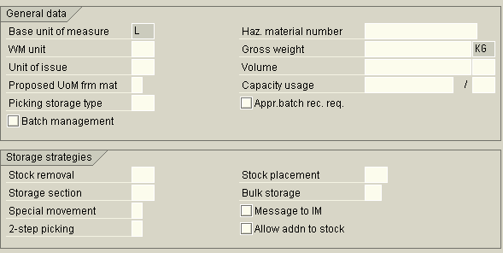
Material Master data for WM
Stragy info for
Putaway &
pickup

Slide 28
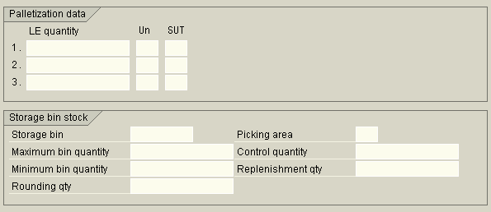
Material Master data for WM
Storage bin
details

Slide 29
Summary
You must have understood
Warehouse concepts
Terminologies in WM
Movement types in WM
Difference between WM and IM
Warehouse strategies

